Slide 1
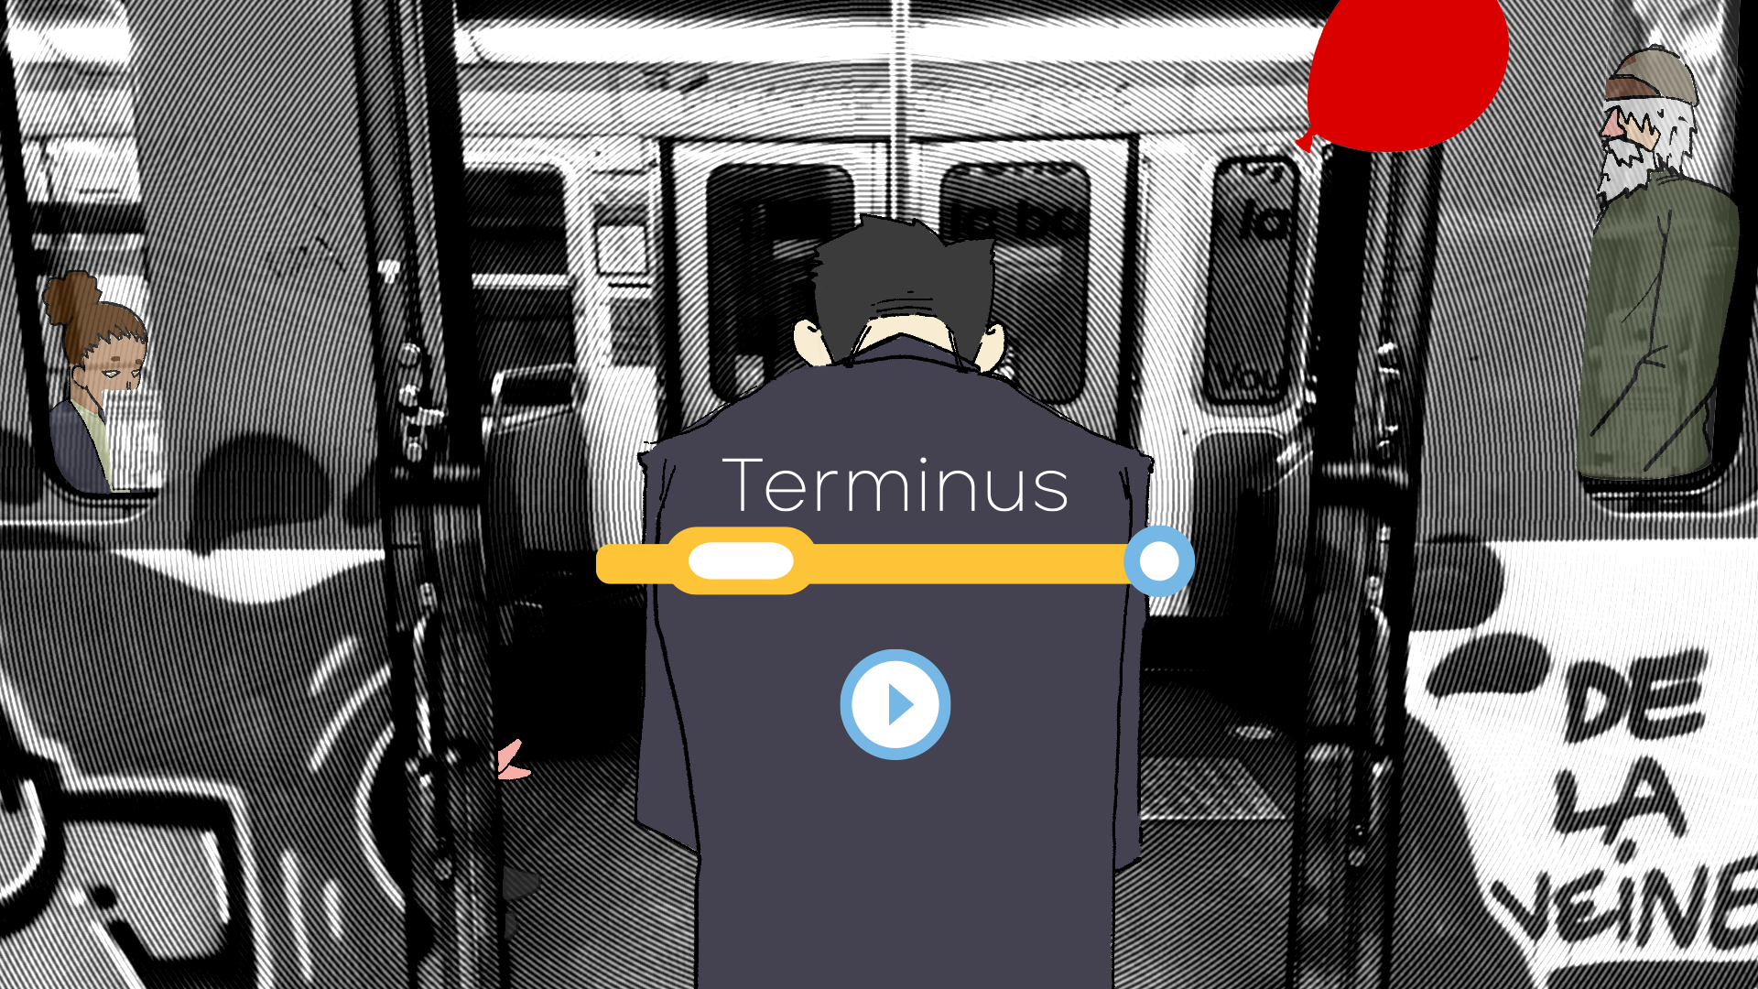


Slide 2
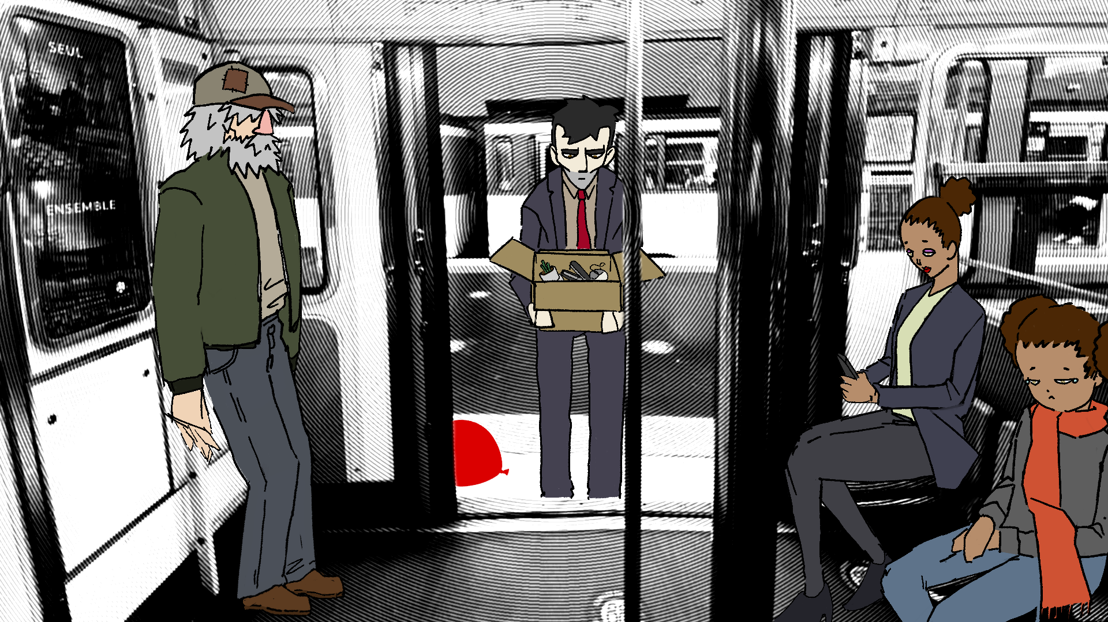

Slide 3
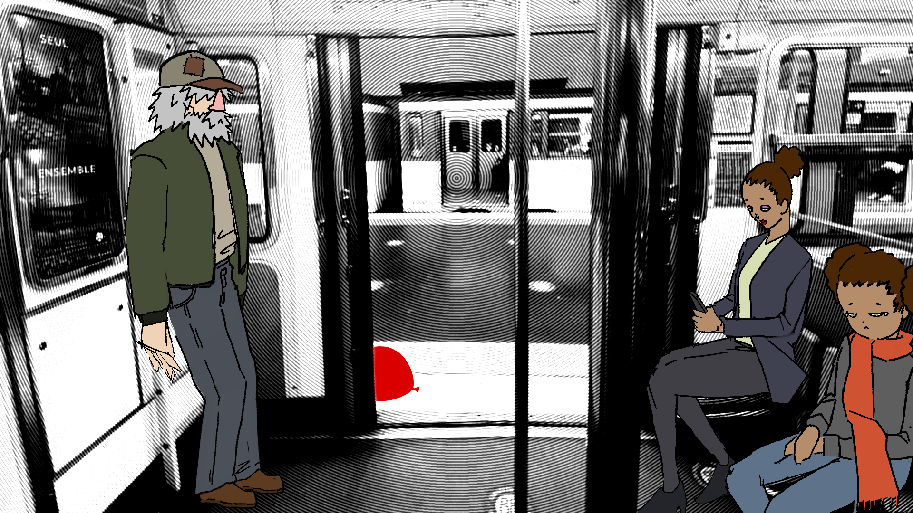

Slide 4
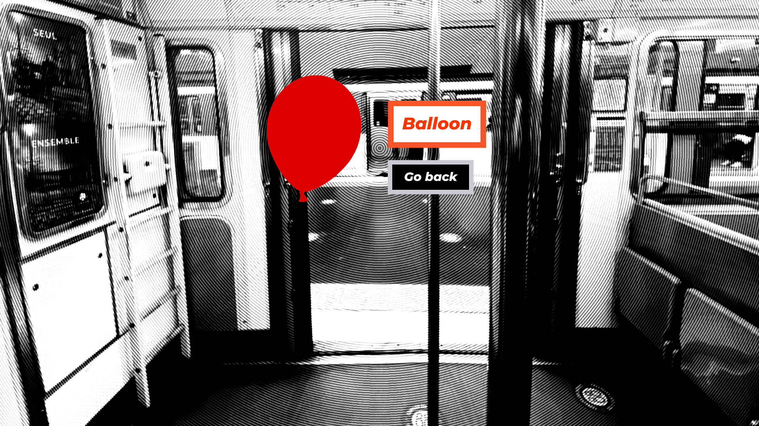

Slide 5
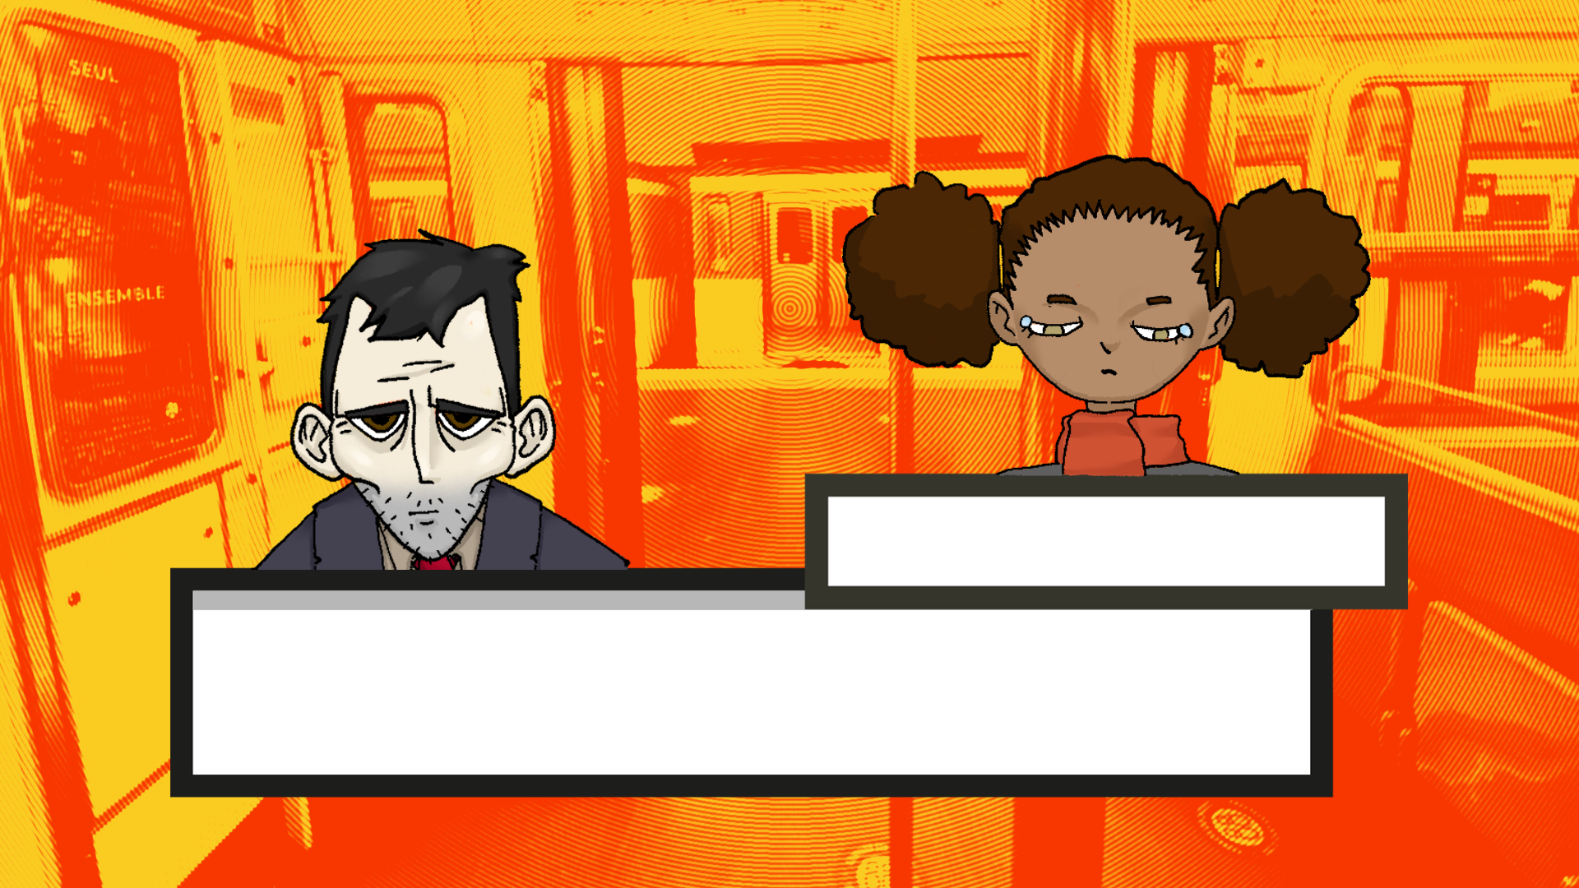

Little girl
I lost my balloon but mum seems too
busy to notice…

Slide 8
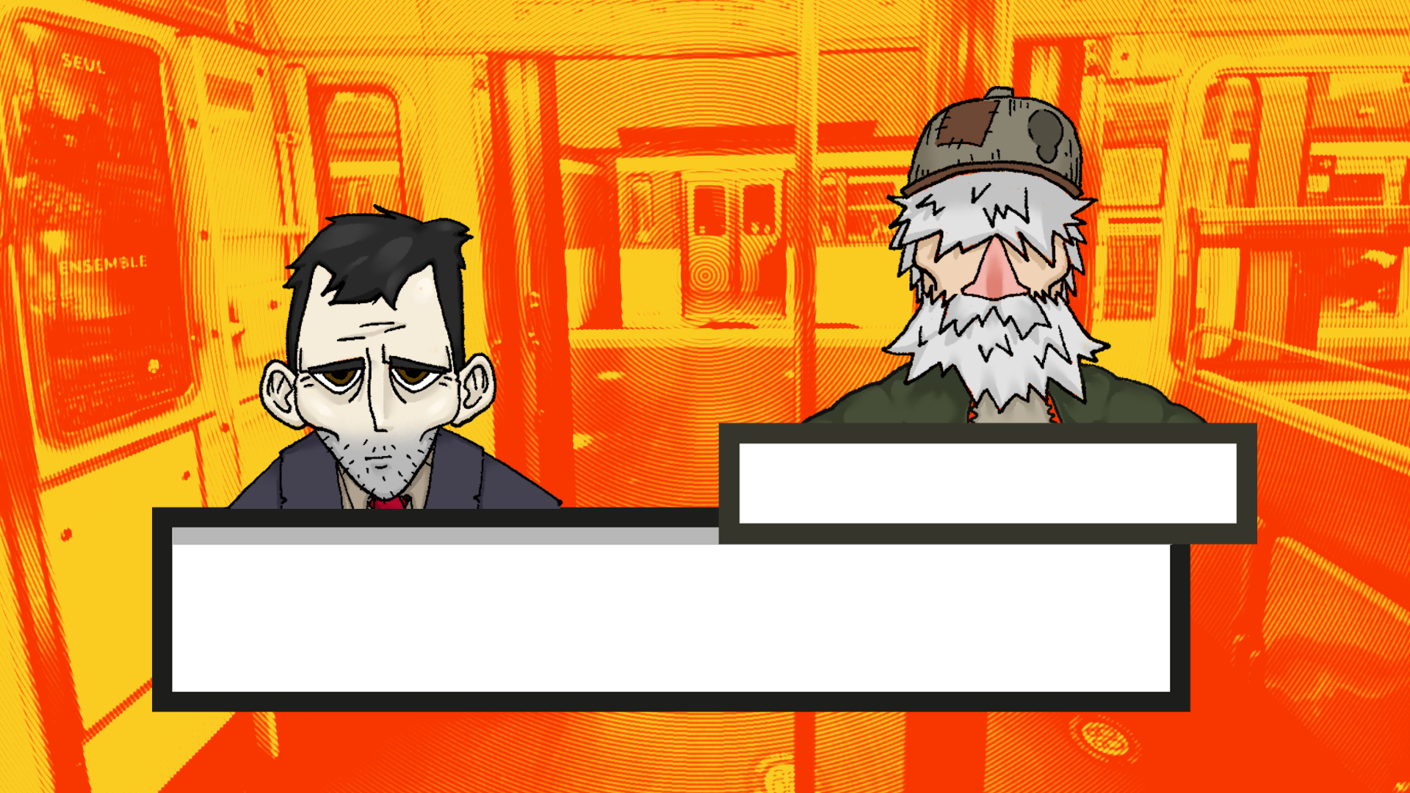
Homeless man
I used to be a clown you know. Everyone loved me

Slide 9
Homeless man
But there’s no job security when you’re
handing out balloon animals

Slide 10
Homeless man
I used to be a clown you know. Everyone loved me

Slide 11
Homeless man
But there’s no job security when you’re
handing out balloon animals

Slide 14
Little girl
I lost my balloon but mum seems
too busy to notice…

Slide 16
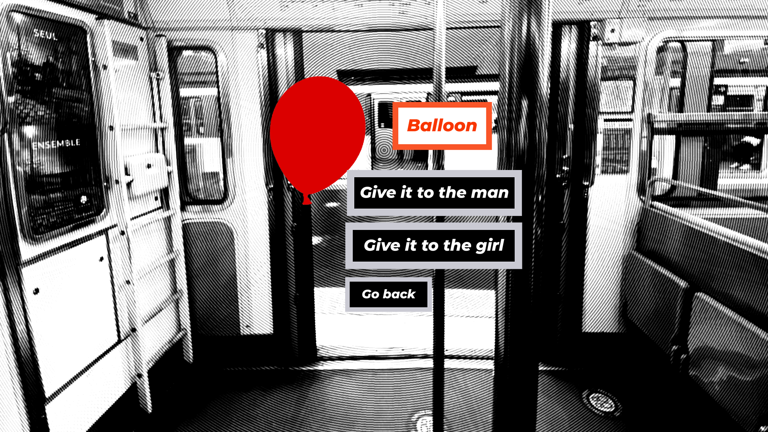

Slide 17
Little girl
Thank you mister. I wonder how old is too old
to enjoy balloons…

Slide 18
Little girl
I don’t think i’ll ever grow out of it.

Slide 19
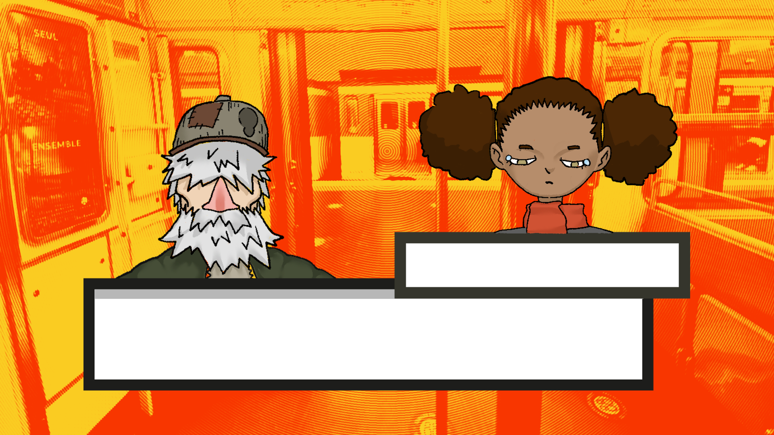

Little girl
You look like you need it more than me.
Have my balloon.

Slide 20
Little girl
That man looked sad… I’m happy
i could make him smile.

Slide 21
Homeless man
Hah, it reminds of the good old days !

Slide 22
Homeless man
You know, i once made a life-size giraffe
out of dozen of these.

Slide 23
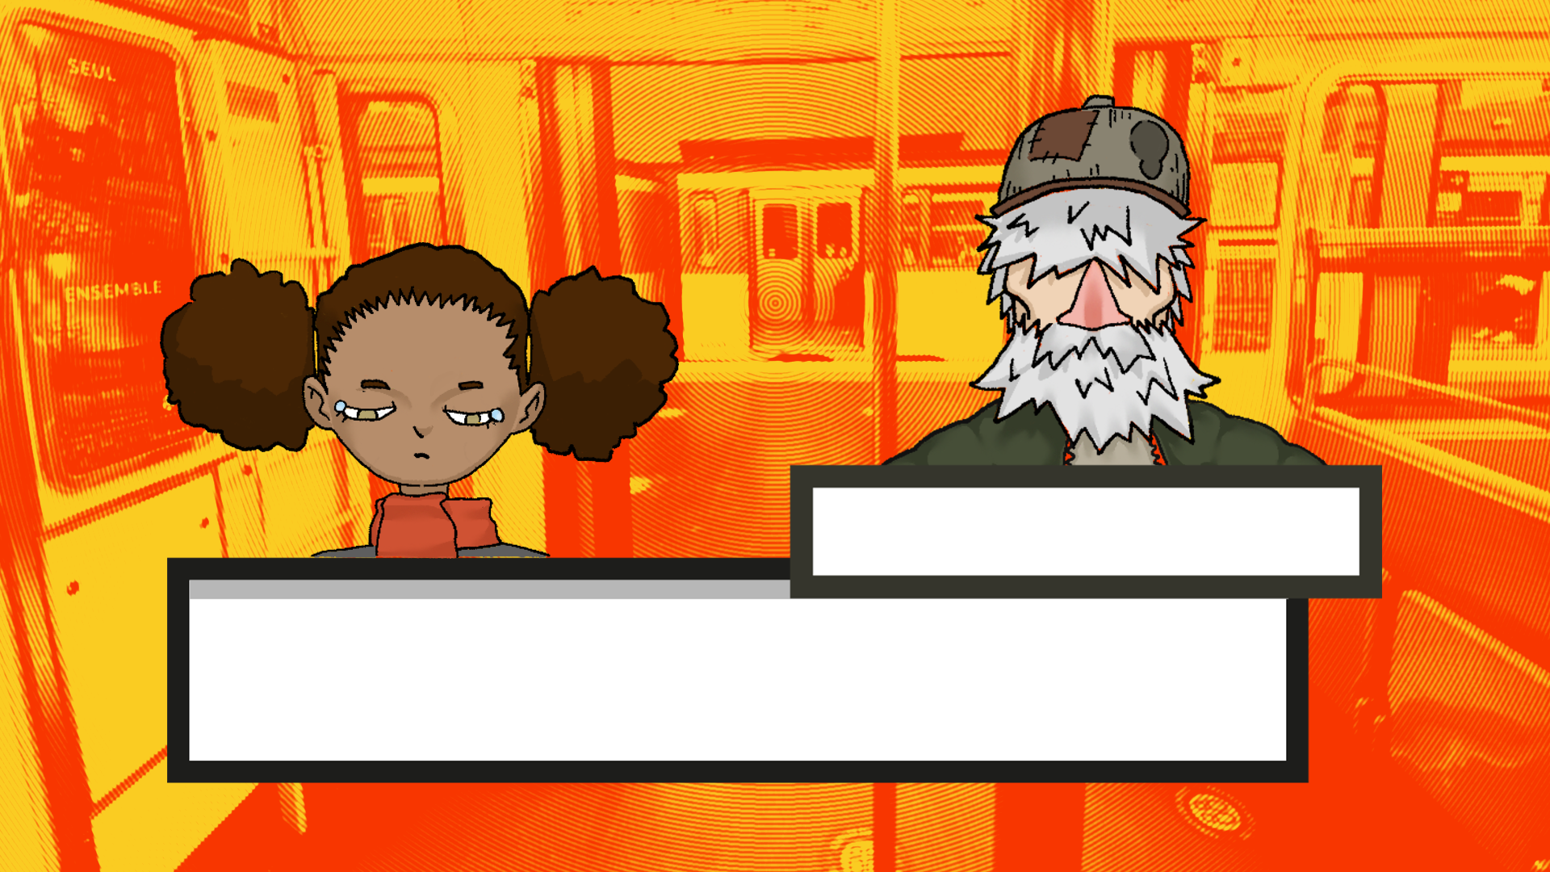

Homeless man
Hey, do you like balloons, kid ?
Here you go !

Slide 24
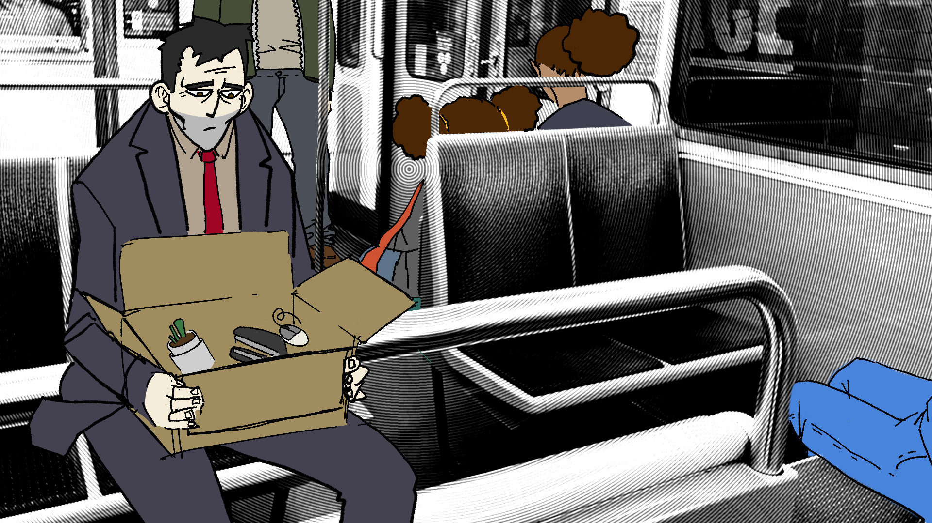

Slide 25
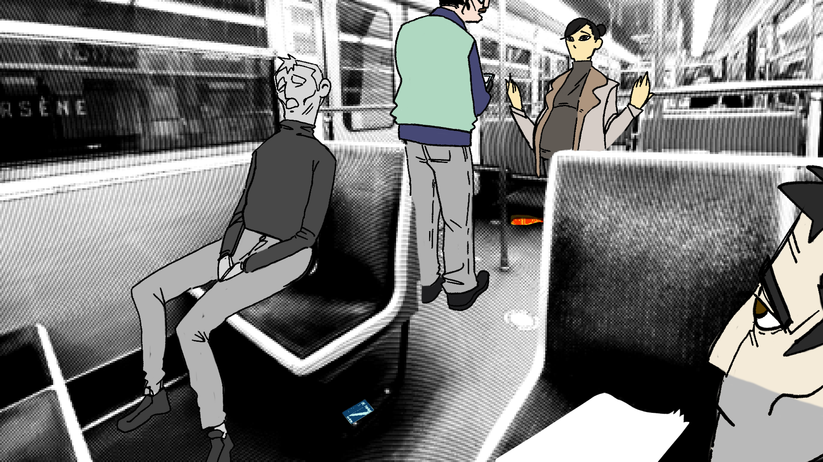

Slide 26
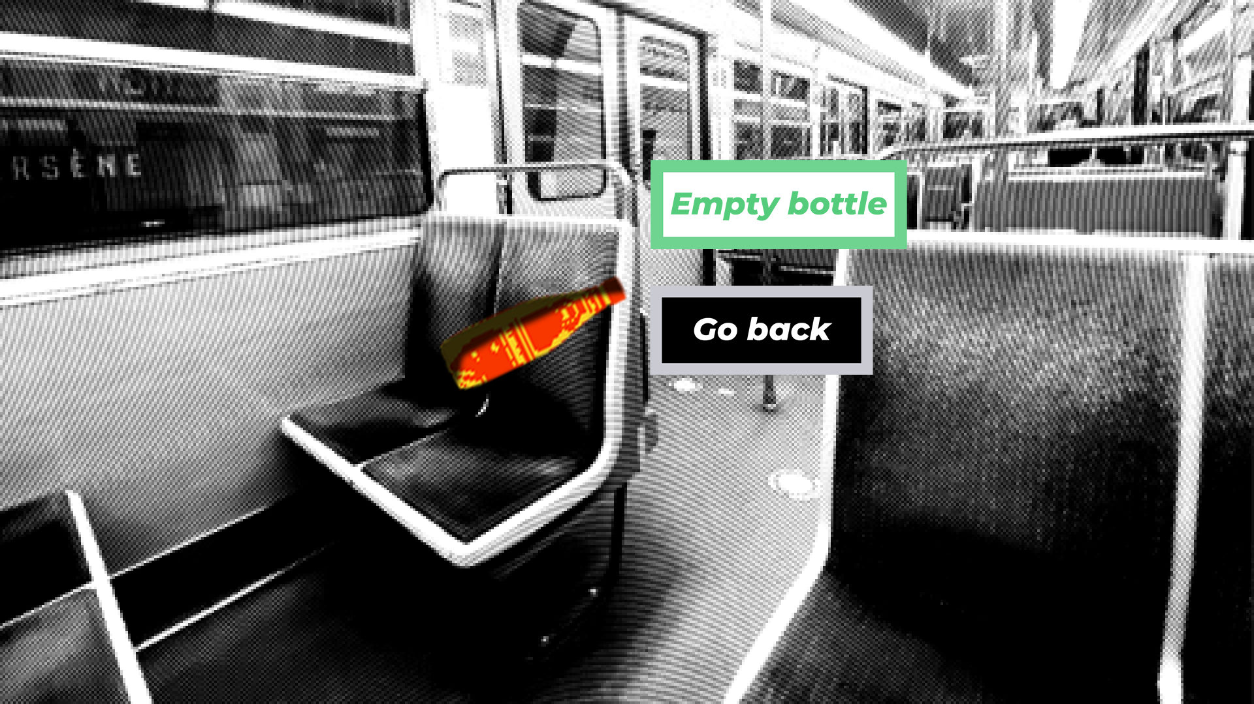

Slide 27
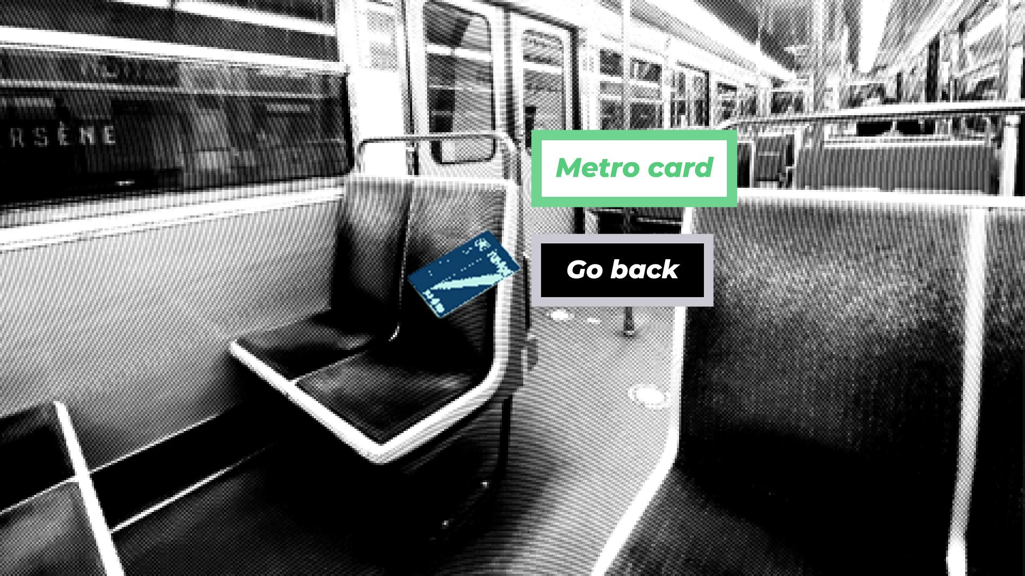

Slide 28
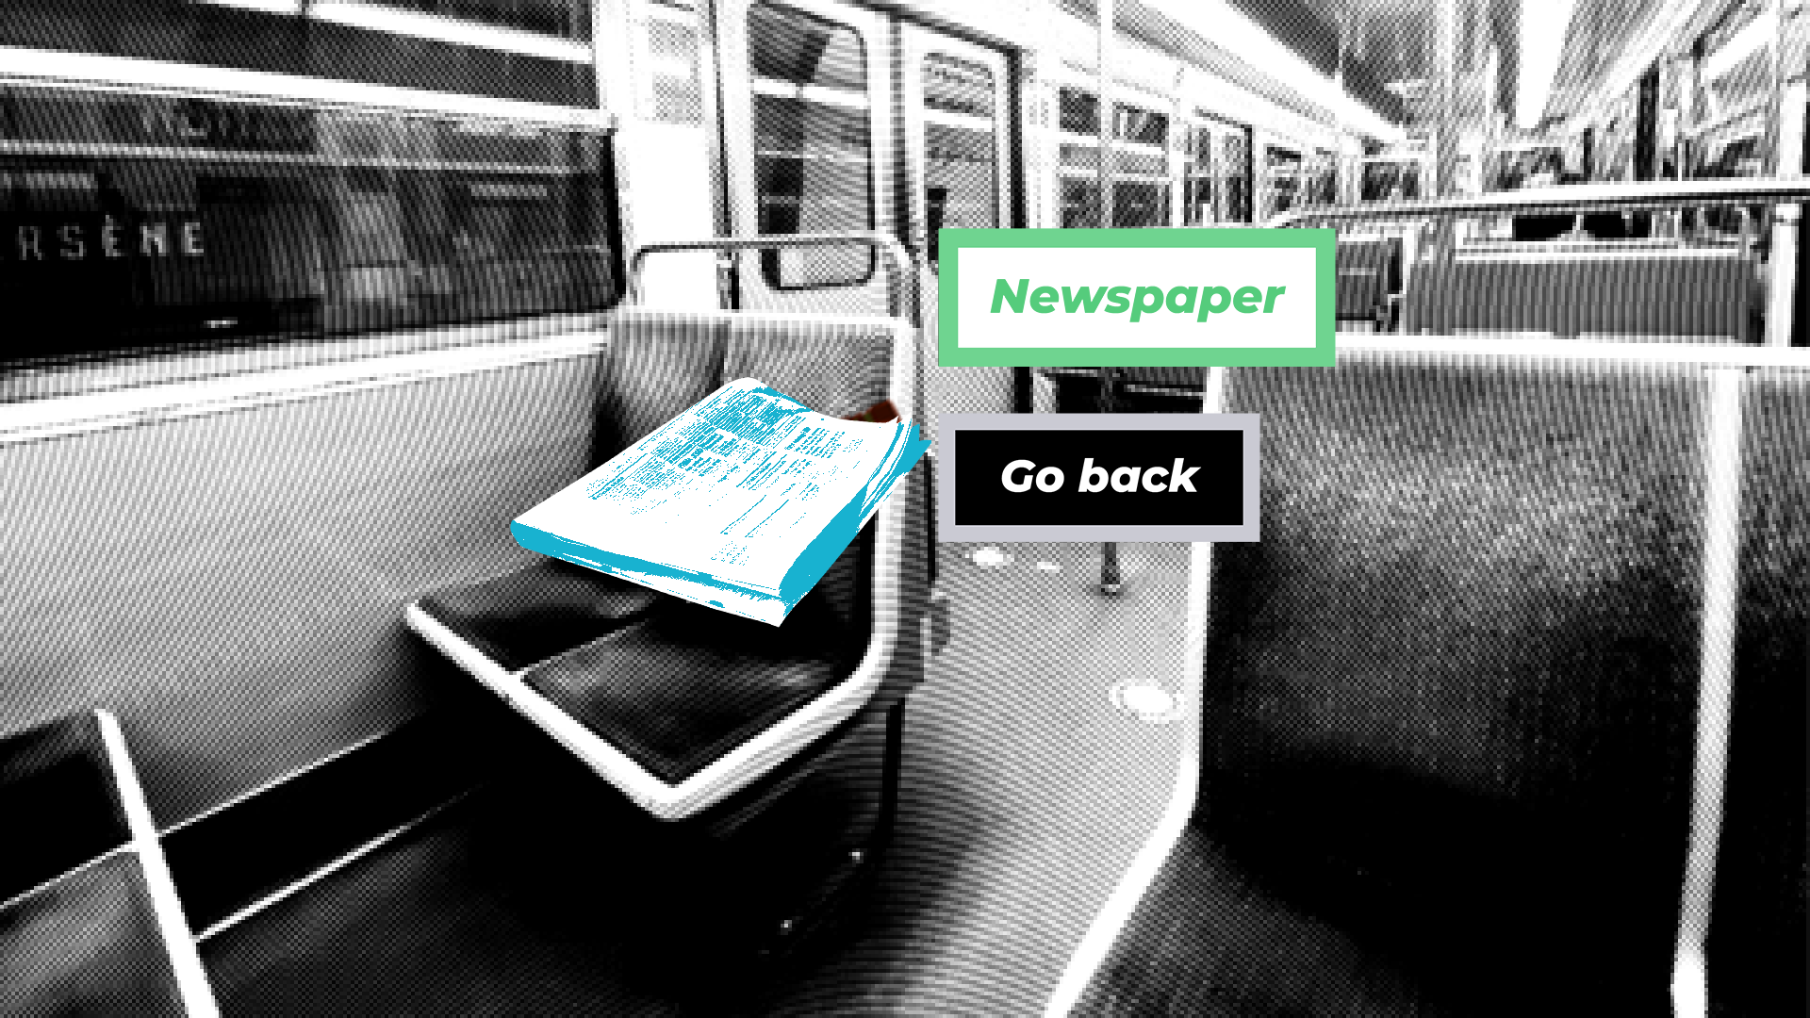

Slide 29
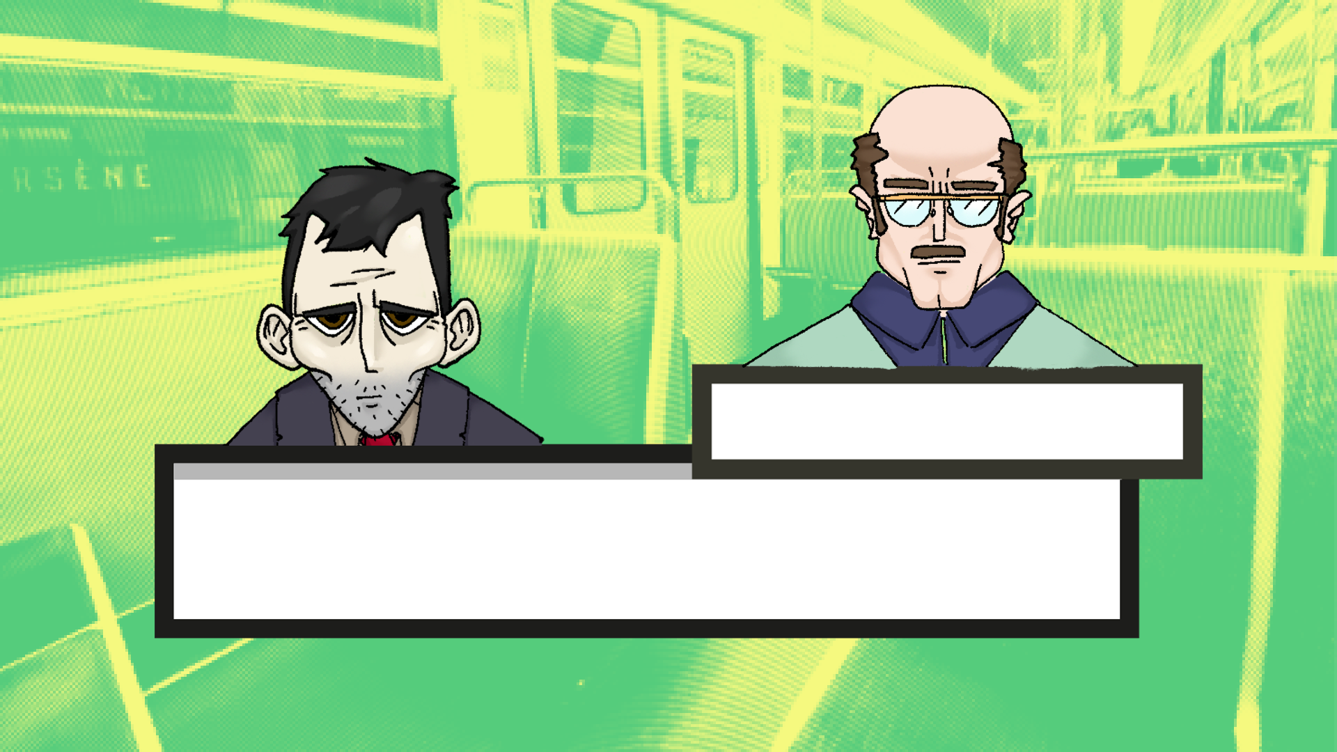
Ticket controller
Please move along, I have a job to do.

Slide 30
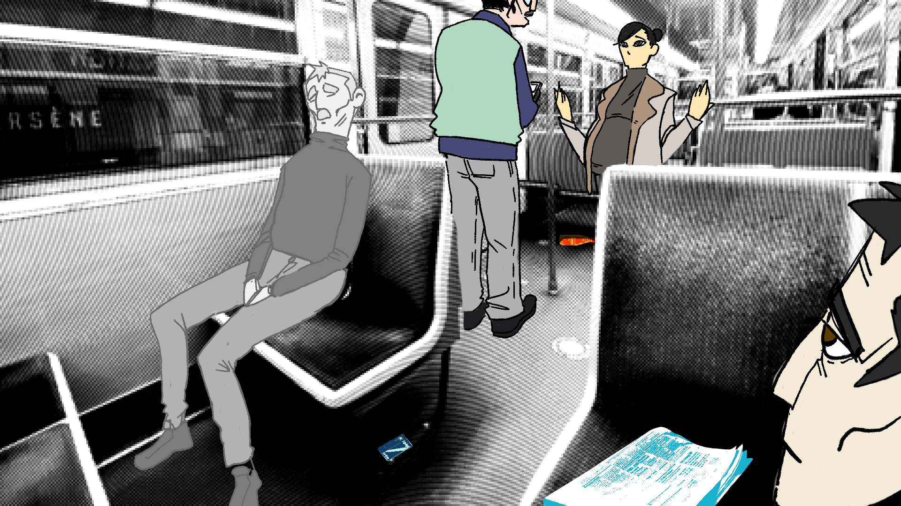

Slide 32
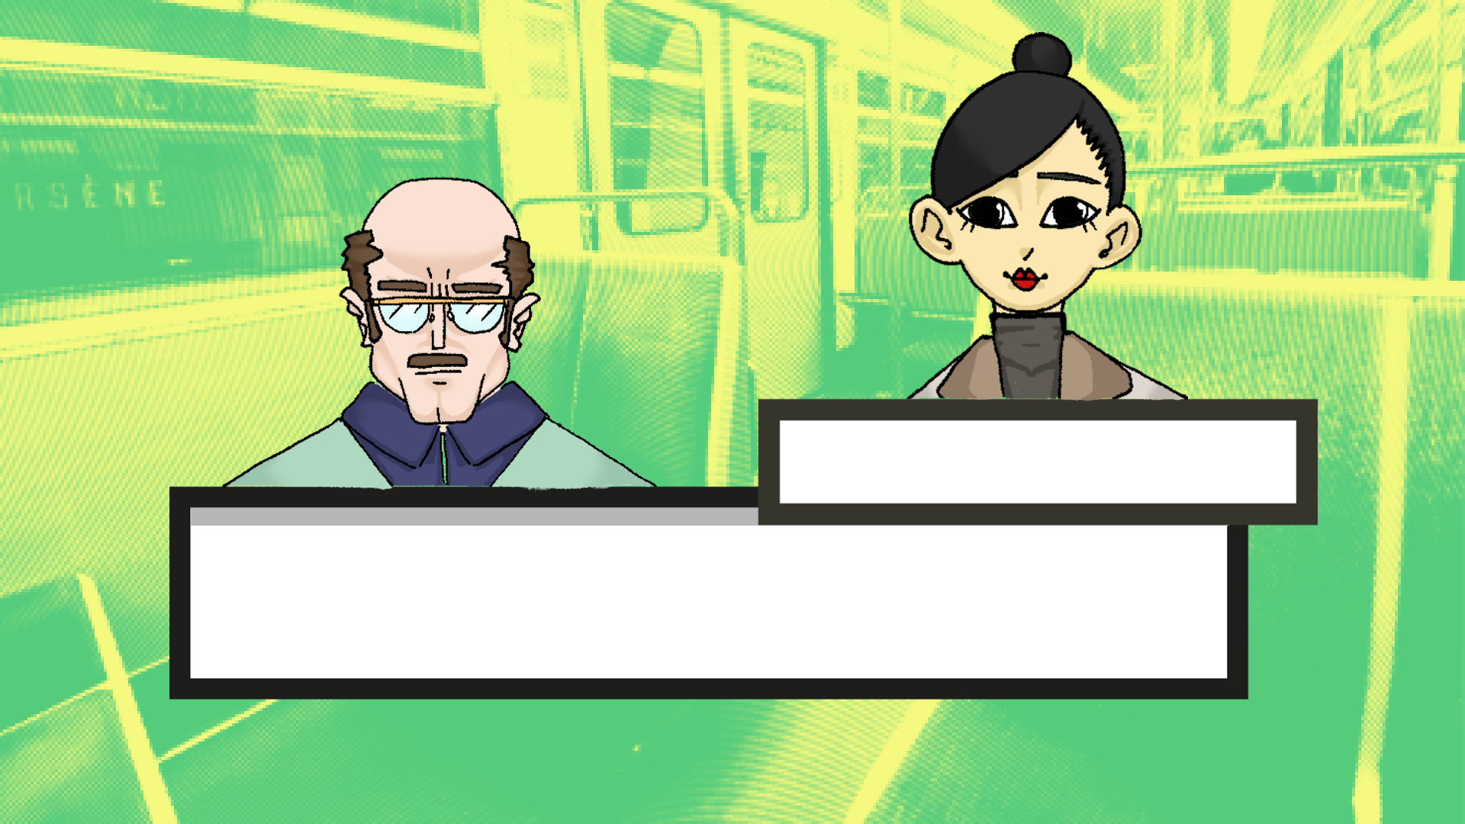
Pregnant woman
I can't find my metro pass ! I swear it was
right there in my bag ?

Slide 33
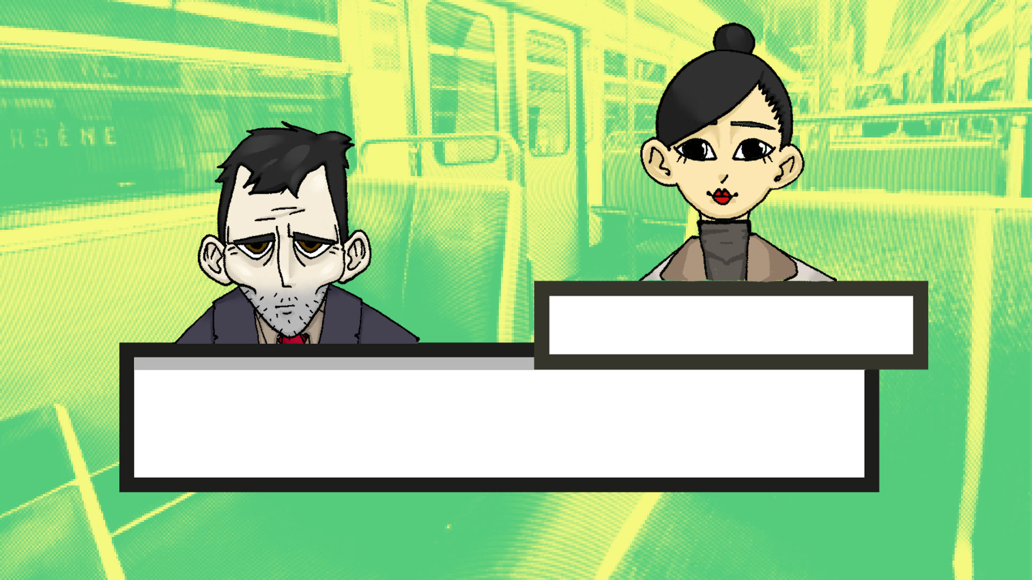
Pregnant woman
I must have dropped it somewhere...

Slide 35
Ticket controller
Please move along, I have a job to do.

Slide 36
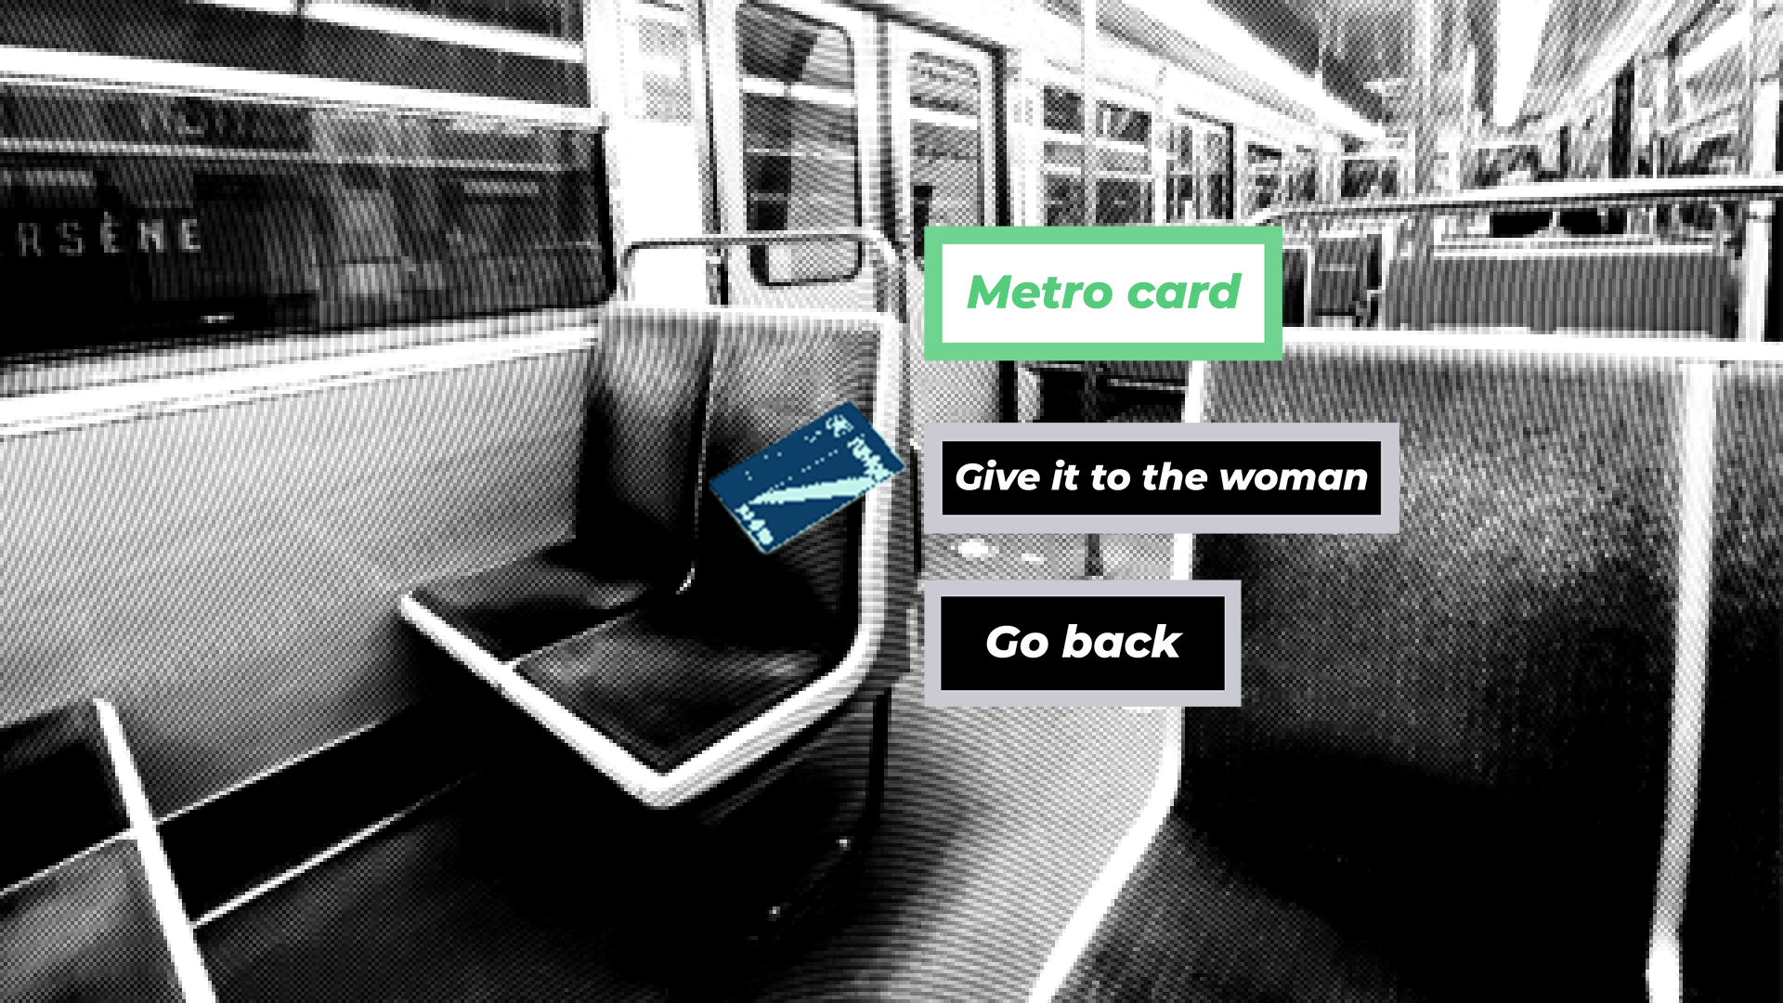

Slide 37
Pregnant woman
Thank you so much !

Slide 38


Slide 39
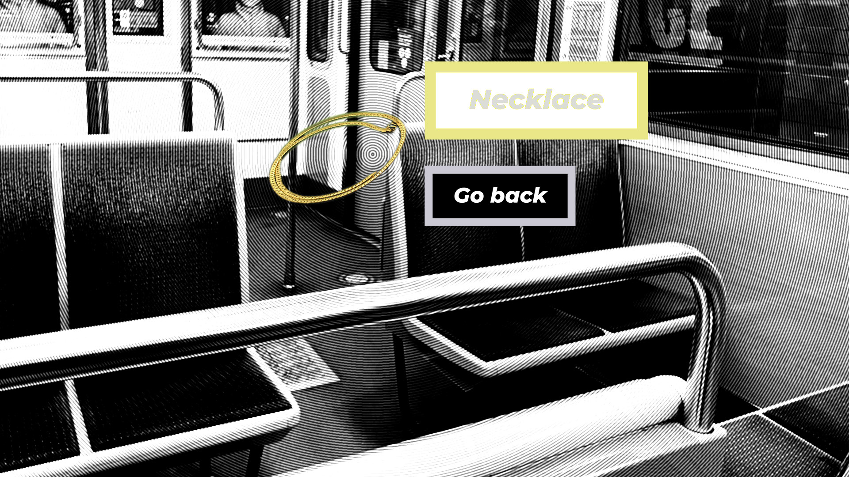

Slide 40
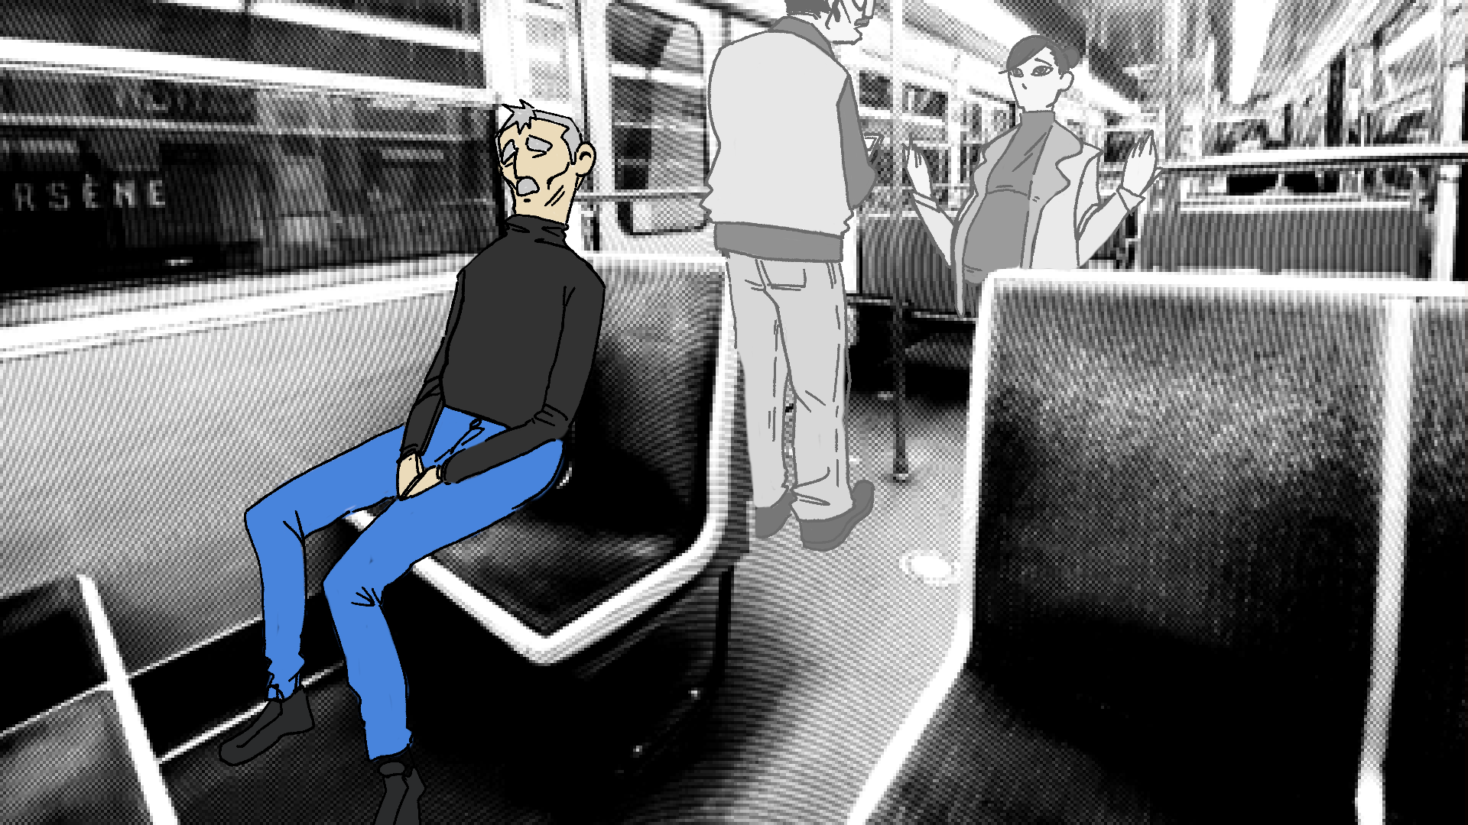

Slide 41
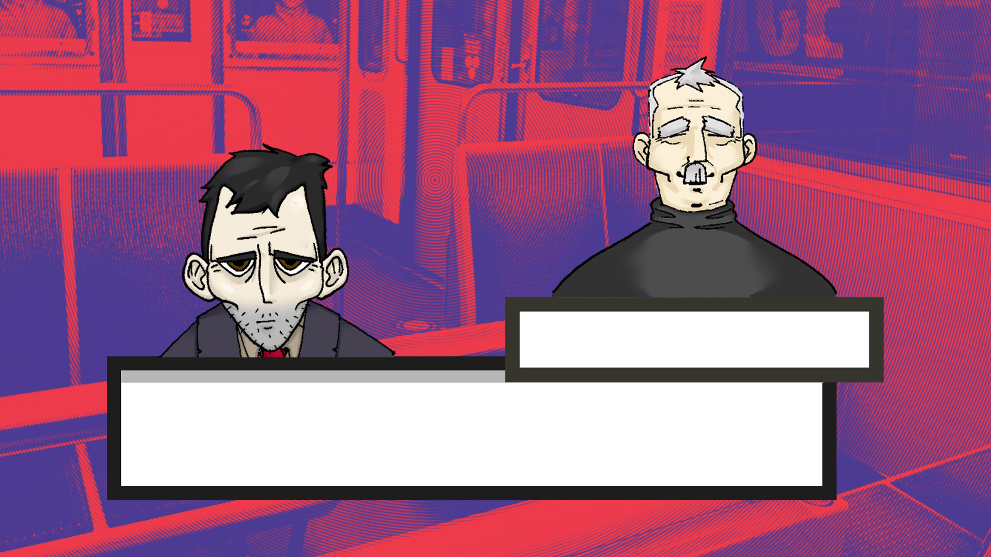
Old man
I seem to have dropped my necklace and it rolled away. Could you find it for me ?

Slide 43
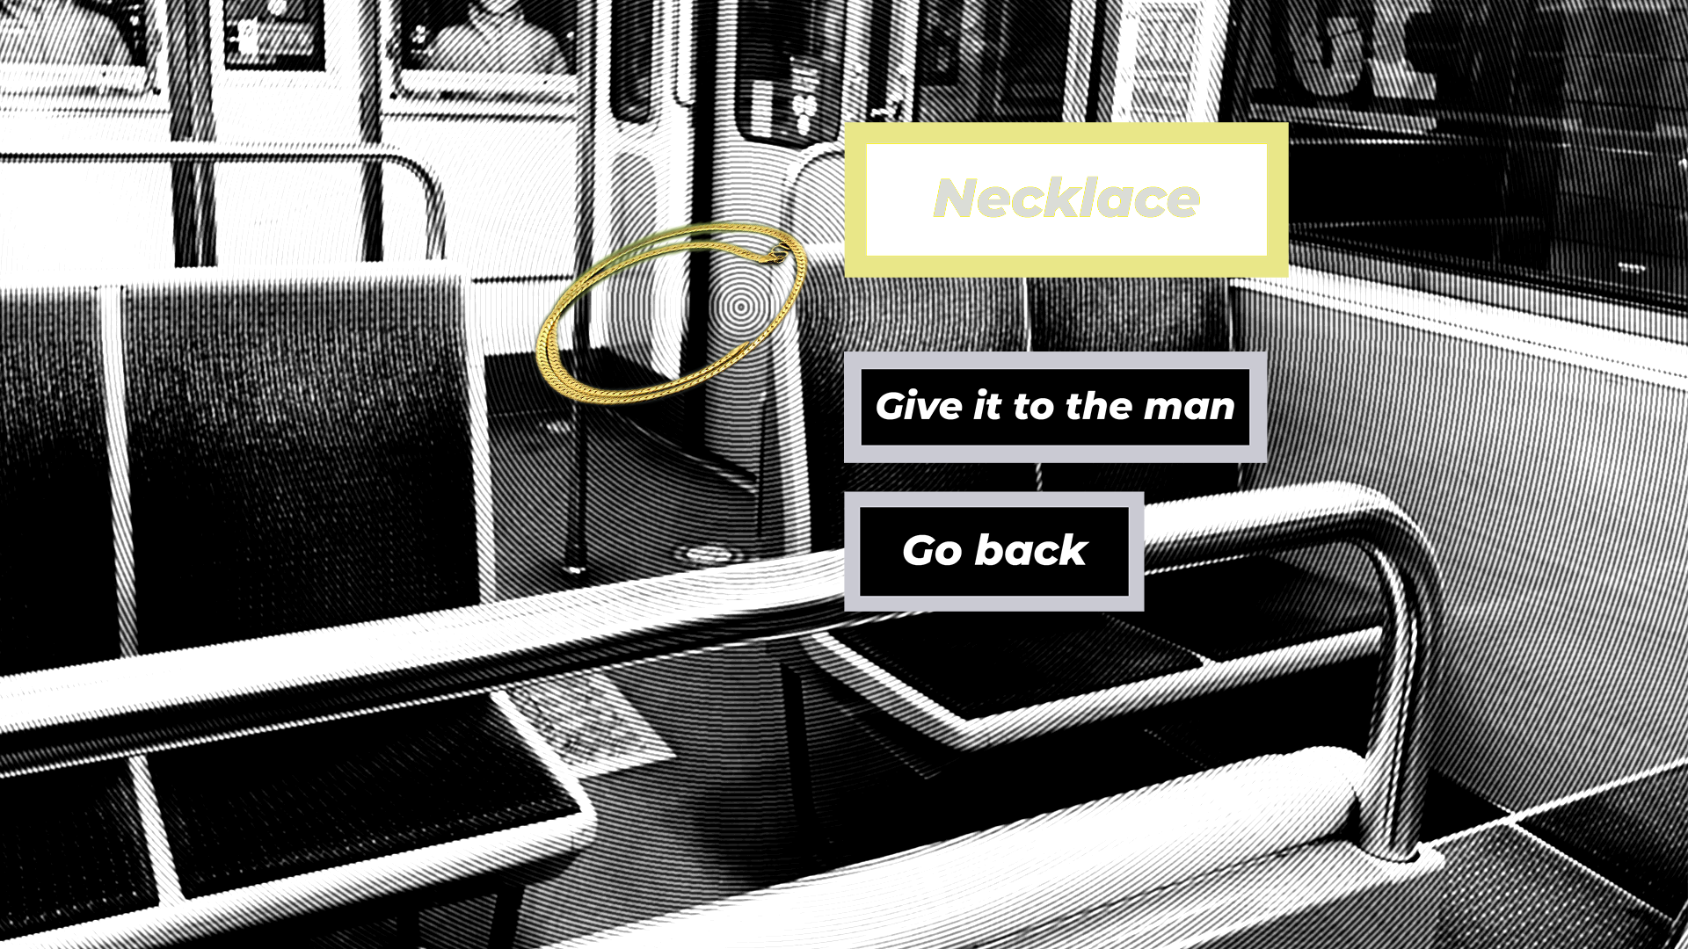

Slide 44
Old man
You might think it's silly for an old man to carry
a necklace, huh ?

Slide 45
Old man
It used to belong to my late wife,
she was the light of my life.

Slide 46
Old man
I keep it close to my heart so that I can feel her with me.

Slide 47

Little girl
That man looked sad... I'm happy I could make him smile.

Slide 48
Homeless man
It had been a while since I had the chance to make
one of these...

Slide 49
Homeless man
Seeing her face light up brought back beautiful memories from my old life.

Slide 50
Pregnant woman
I'm so tired these days…

Slide 51
Pregnant woman
I have so many things to prepare for… I can't keep track of the simplest things.

Slide 52
Pregnant woman
I'm so happy you chose to help me with my metro pass. It made my day a little easier.

Slide 53
Old man
I can see that you're going through something right now, but hang in there.

Slide 54
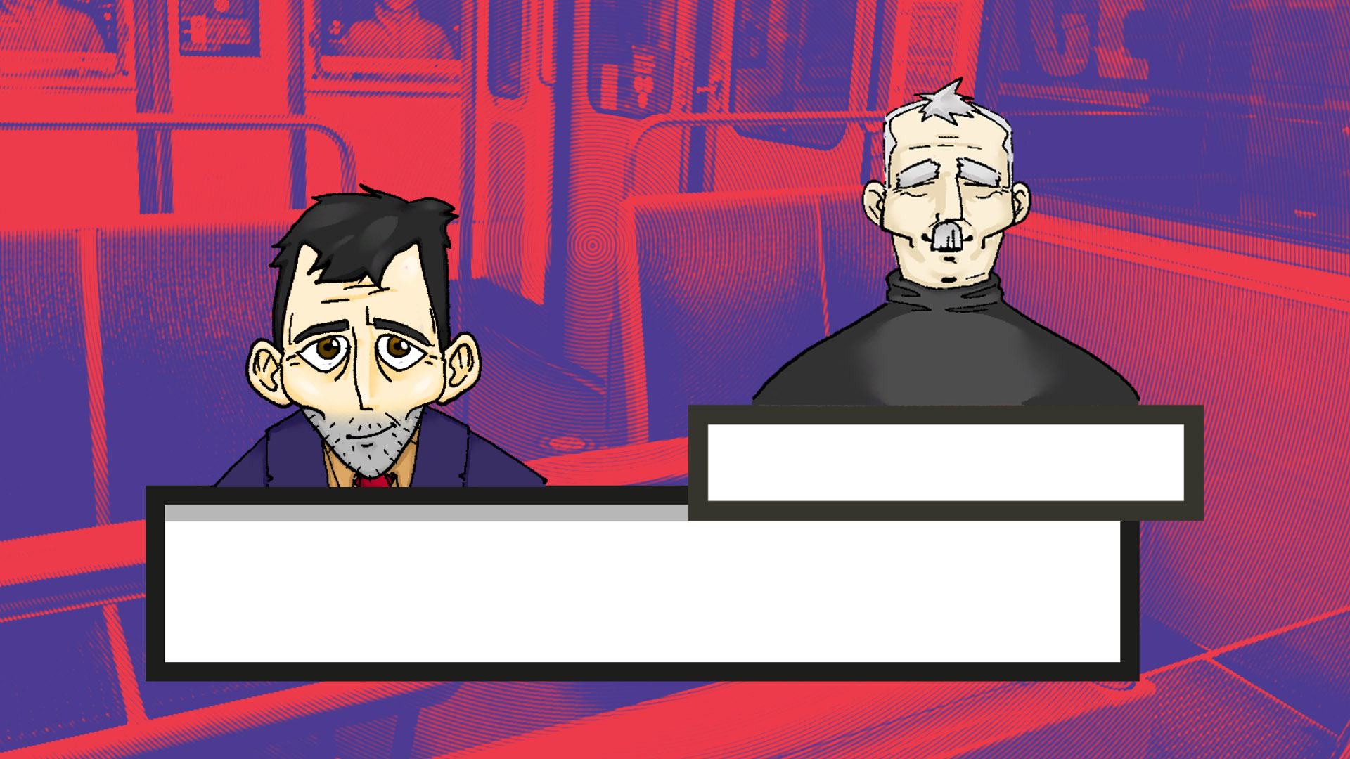
Old man
Have you seen how much happier you made people who asked for help ?

Slide 55
Old man
You shouldn't hesitate to ask for help yourself, it makes life that much easier.

Slide 56
Old man
Know that you can find happiness in others, young man, and you’ll never have to search for it again.

